Slide 1

Information Security Engr. Syed Rizwan

Slide 2
More Definitions
Unconditional security
no matter how much computer power or time is available, the cipher cannot be broken since the ciphertext provides insufficient information to uniquely determine the corresponding plaintext
Computational security
given limited computing resources (e.g. time needed for calculations is greater than age of Universe), the cipher cannot be broken

Slide 3
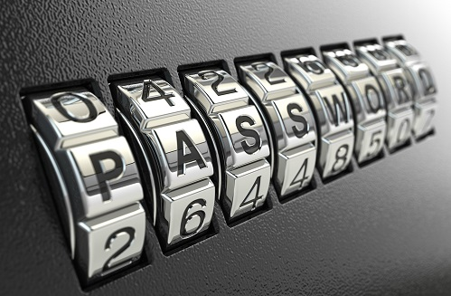
Average time to exhaustive Brute Force

Slide 4
The Types of Operations
The Substitution Cipher
A substitution cipher is one in which the letters of plaintext are replaced by other letters or by numbers or symbols.
If the plaintext is viewed as a sequence of bits, then substitution involves replacing plaintext bit patterns with ciphertext bit patterns.

Slide 5
The Types of Operations
The Substitution Cipher
When letters are involved, the following conventions is used:
plaintext is always in lowercase;
Ciphertext is in UPPERCASE;
key values are in italicized lowercase.

Slide 6
The Types of Operations
The Caesar Cipher
The earliest known, and the simplest, use of a substitution cipher was by Julius Caesar.
The Caesar cipher involves replacing each letter of the alphabet with the letter standing few (typically three) places further down the alphabet.

Slide 7
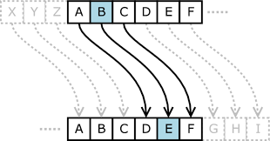
The Types of Operations
The Caesar Cipher
For example
plaintext: meet me after the toga party
ciphertext: PHHW PH DIWHU WKH WRJD SDUWB
Plaintext | a | b | c | d | e | f | g | h | i | j | k | l | m | n | o | p | q | r | s | t | u | v | w | x | y | z
Ciphertext | D | E | F | G | H | I | J | K | L | M | N | O | P | Q | R | S | T | U | V | W | X | Y | Z | A | B | C

Slide 8
The Types of Operations
The Caesar Cipher
Note that the alphabet is wrapped around, so that the letter following Z is A.
We can define the transformation by listing all possibilities, as follows:
OR if we assign a numerical equivalent to each letter
Plaintext | a | b | c | d | e | f | g | h | i | j | k | l | m | n | o | p | q | r | s | t | u | v | w | x | y | z
Ciphertext | D | E | F | G | H | I | J | K | L | M | N | O | P | Q | R | S | T | U | V | W | X | Y | Z | A | B | C
Plaintext | a | b | c | d | e | f | g | h | i | j | k | l | m | n | o | p | q | r | s | t | u | v | w | x | y | z
Ciphertext | 0 | 1 | 2 | 3 | 4 | 5 | 6 | 7 | 8 | 9 | 10 | 11 | 12 | 13 | 14 | 15 | 16 | 17 | 18 | 19 | 20 | 21 | 22 | 23 | 24 | 25

Slide 9
The Types of Operations
The Caesar Cipher
The Modulo Math states that
a mod n to be the remainder when a is divided by n.
For example, 11 mod 7 = 4.
So, mathematically, the algorithm can be expressed as follows. For each plaintext letter p, substitute the ciphertext letter C.
C = E(3, p) = (p + 3) mod 26

Slide 10
The Types of Operations
The Caesar Cipher
A shift may be of any amount, so that the general Caesar algorithm is
C = E(k, p) = (p + k) mod 26
Where takes on a value in the range 1 to 25.
The decryption algorithm is simply
p = D(k, C) = (C - k) mod 26

Slide 11
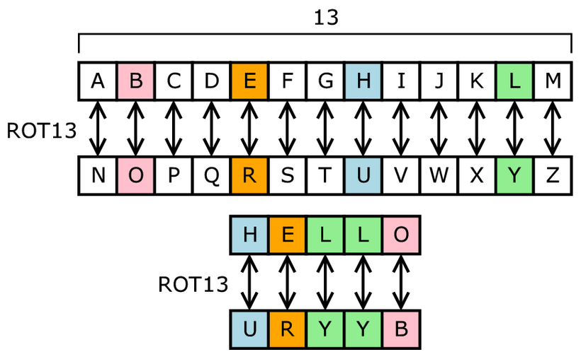
The Types of Operations
The Caesar Cipher (ROT-13)

Slide 12
The Types of Operations
The Caesar Cipher - Problem
If it is known that a given ciphertext is a Caesar cipher, then a brute-force cryptanalysis is easily performed.
Simply try all the 25 possible keys.

Slide 13
The Types of Operations
The Caesar Cipher-Problem

Slide 14
The Types of Operations
The Caesar Cipher - Problem
Three important characteristics of this problem enabled possible brute force cryptanalysis:
The encryption and decryption algorithms are known.
There are only 25 keys to try.
The language of the plaintext is known and easily recognizable.

Slide 15
The Types of Operations
The Caesar Cipher - Problem
The algorithms are usually known.
To make brute force difficult, we should employ a large number of keys.
If the language of the plaintext is unknown, then plaintext output may not be recognizable. The input may be abbreviated or compressed in some fashion, again making recognition difficult.

Slide 16
The Substitution Ciphers
The Caesar Cipher - Problem
Sample of unknown or compressed plaintext

Slide 17
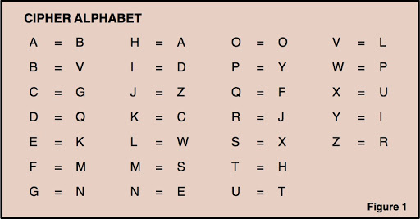
The Substitution Ciphers
The Mono-alphabetic Cipher
A dramatic increase in the key space can be achieved by allowing an arbitrary substitution.

Slide 18
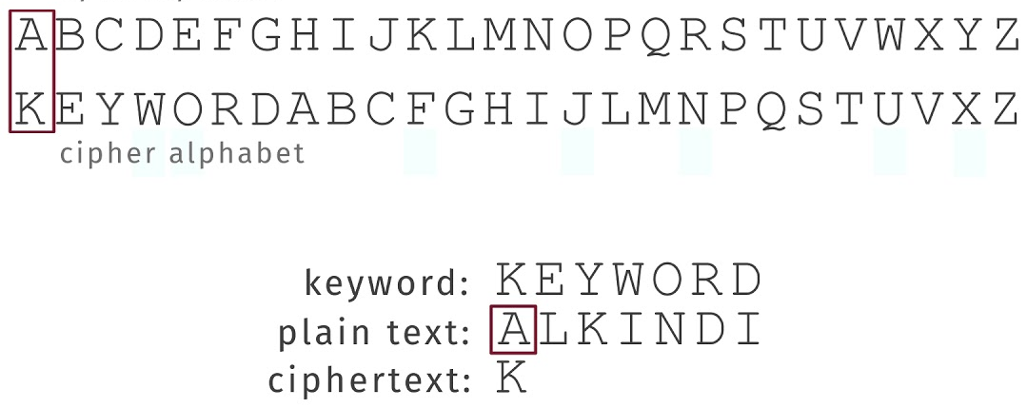
The Substitution Ciphers
The Mono-alphabetic Cipher
A dramatic increase in the key space can be achieved by allowing an arbitrary substitution.

Slide 19
The Substitution Ciphers
The Mono-alphabetic Cipher -Problem
If the cryptanalyst knows the nature of the plaintext (e.g., non-compressed English text), then the analyst can exploit the regularities of the language.
Every language has certain frequency distribution of its letters, so as English language.
The frequency distribution of English language is as follows:

Slide 20
The Substitution Ciphers
The Mono-alphabetic Cipher -Problem

Slide 21
The Substitution Ciphers
The Mono-alphabetic Cipher –Problem
To see how such a cryptanalysis might proceed, we give a partial example here. The ciphertext to be solved is
UZQSOVUOHXMOPVGPOZPEVSGZWSZOPFPESXUDBMETSXAIZVUEPHZHMDZSHZOWSFPAPPDTSVPQUZWYMXUZUHSXEPYEPOPDZSZUFPOMBZWPFUPZHMDJUDTMOHMQ

Slide 22
The Substitution Ciphers
The Mono-alphabetic Cipher –Problem

Slide 23
The Substitution Ciphers
The Mono-alphabetic Cipher –Problem
As a first step, the relative frequency of the letters can be determined and compared to a standard frequency distribution for English.
If the message were long enough, this technique alone might be sufficient, but because this is a relatively short message, we cannot expect an exact match.

Slide 24
The Substitution Ciphers
The Mono-alphabetic Cipher –Problem
Comparing this breakdown with frequency distribution of English, it seems likely that cipher letters P and Z are the equivalents of plain letters e and t, but it is not certain which is which.
The letters S,U,O,M, and H are all of relatively high frequency and probably correspond to plain letters from the set {a, h, i, n, o, r, s}.
The letters with the lowest frequencies (namely, A,B,G,Y, I, J) are likely included in the set {b, j, k, q, v, x, z}

Slide 25
The Substitution Ciphers
The Mono-alphabetic Cipher –Problem
UZQSOVUOHXMOPVGPOZPEVSGZWSZOPFPESXUDBMETSXAIZ
t a e e te a t h a t e e a a
VUEPHZHMDZSHZOWSFPAPPDTSVPQUZWYMXUZUHSX
e t t a t h a e ee a e t h t a
EPYEPOPDZSZUFPOMBZWPFUPZHMDJUDTMOHMQ
e e e t a t e t h e t
it was disclosed yesterday that several informal but
direct contacts have been made with political
representatives of the vietcong in moscow

Slide 26
The Substitution Ciphers
The Homophone Cipher
The great mathematician Carl Friedrich Gauss believed that he had devised an unbreakable cipher using homophones.
The Homophonic Substitution cipher is a substitution cipher in which single plaintext letters can be replaced by any of several different ciphertext letters.

Slide 27
The Substitution Ciphers
The Homophone Cipher
They are generally much more difficult to break than standard substitution ciphers.
The number of characters each letter is replaced by is part of the key, e.g. the letter 'E' might be replaced by any of 5 different symbols, while the letter 'Q' may only be substituted by 1 symbol.

Slide 28
The Substitution Ciphers
The Homophone Cipher
The letter 'E' is usually the most common letter in english, so the most common ciphertext letter will probably be 'E'. If we allow the letter 'E' to be replaced by any of 3 different characters, then we can no longer just take the most common letter, since the letter count of 'E' is spread over several characters.

Slide 29
The Substitution Ciphers
The Homophone Cipher
Plaintext | a | b | c | d | e | f | g | h | i | j | k | l | m | n | o | p | q | r | s | t | u | v | w | x | y | z
Ciphertext | D | X | S | F | Z | E | H | C | V | I | T | P | G | A | Q | L | K | J | R | U | O | W | M | Y | B | N
 | 9 |  |  |  | 7 |  |  |  | 3 |  |  |  |  | 5 | 0 |  |  |  | 4 | 6
 |  |  |  |  | 2
 |  |  |  |  | 1
Plaintext | d | e | f | e | n | d |  | t | h | e |  | e | a | s | t |  | w | a | l | l |  | o | f |  | c | a | s | t | l | e
Ciphertext | F | 7 | E | Z | 5 | F |  | U | C | 2 |  | 1 | D | R | 6 |  | M | 9 | P | P |  | 0 | E |  | S | D | 4 | U | P | 1

Slide 30
Questions ?

